Slide 1
COMP4901K/Math4824B Machine Learning for Natural Language Processing
Lecture 22: Attention Models
Instructor: Yangqiu Song
Slides credits: Richard Socher, Vagelis Hristidis, Abigail See, Elena Voita

Slide 2
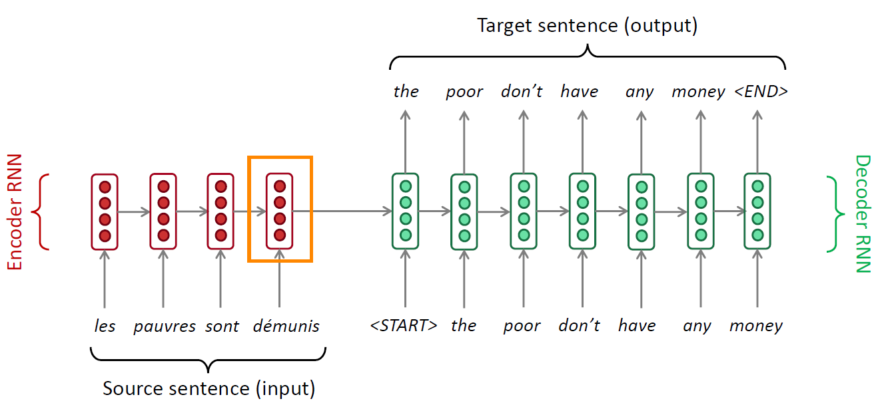
Sequence-to-sequence: the bottleneck problem
Encoding of the
source sentence.

Slide 3
Sequence-to-sequence: the bottleneck problem
Encoding of the
source sentence.
This needs to capture all
information about the
source sentence.
Information bottleneck!

Slide 4
Attention
Attention provides a solution to the bottleneck problem.
Core idea: on each step of the decoder, focus on a particular part of the source sequence

Slide 5
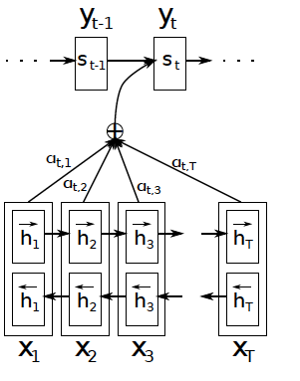
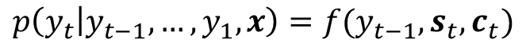
Jointly Learning to Align and Translate
Attention mechanism
$$p\left(y_{t} | y_{t−1},…,y_{1},x\right)=f(y_{t−1},s_{t},c_{t})$$

Slide 6
Jointly Learning to Align and Translate
Attention mechanism
$$p\left(y_{t} | y_{t−1},…,y_{1},x\right)=f(y_{t−1},s_{t},c_{t})$$

Slide 7
Jointly Learning to Align and Translate
Attention mechanism
$$p\left(y_{t} | y_{t−1},…,y_{1},x\right)=f(y_{t−1},s_{t},c_{t})$$

Slide 8
Jointly Learning to Align and Translate
Attention mechanism
$$p\left(y_{t} | y_{t−1},…,y_{1},x\right)=f(y_{t−1},s_{t},c_{t})$$

Slide 9
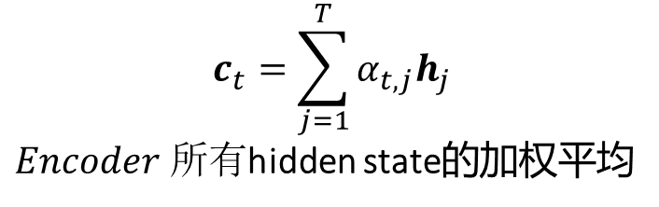
Jointly Learning to Align and Translate
Attention mechanism
$$p\left(y_{t} | y_{t−1},…,y_{1},x\right)=f(y_{t−1},s_{t},c_{t})$$
$$c_{t}=\sum_{j=1}^{T}{α_{t,j}h_{j}}$$
$Encoder 所有$hidden state的加权平均

Slide 10
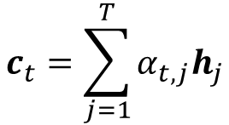
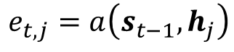
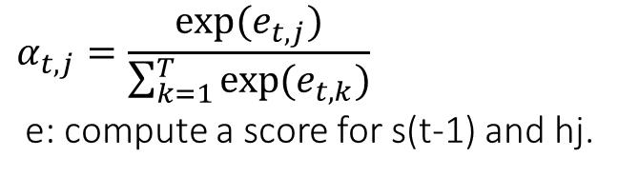
Jointly Learning to Align and Translate
Attention mechanism
$$p\left(y_{t} | y_{t−1},…,y_{1},x\right)=f(y_{t−1},s_{t},c_{t})$$
$$c_{t}=\sum_{j=1}^{T}{α_{t,j}h_{j}}$$
$$α_{t,j}=\frac{exp⁡(e_{t,j})}{\sum_{k=1}^{T}{exp⁡(e_{t,k})}}$$
e: compute a score for s(t-1) and hj.
$$e_{t,j}=a\left(s_{t−1},h_{j}\right)$$

Slide 11
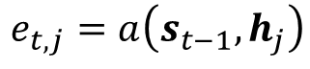
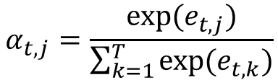
Jointly Learning to Align and Translate
Attention mechanism
$$p\left(y_{t} | y_{t−1},…,y_{1},x\right)=f(y_{t−1},s_{t},c_{t})$$
$$c_{t}=\sum_{j=1}^{T}{α_{t,j}h_{j}}$$
$$α_{t,j}=\frac{exp⁡(e_{t,j})}{\sum_{k=1}^{T}{exp⁡(e_{t,k})}}$$
$$e_{t,j}=a\left(s_{t−1},h_{j}\right)$$

Slide 12
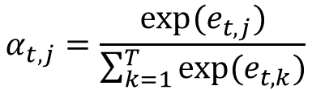
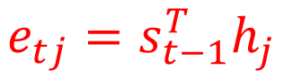
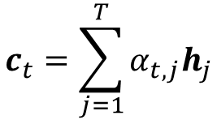
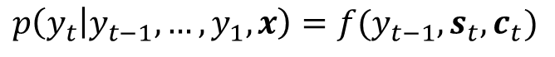
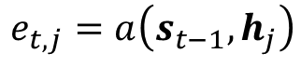
Attention variants
$$p\left(y_{t} | y_{t−1},…,y_{1},x\right)=f(y_{t−1},s_{t},c_{t})$$
$$c_{t}=\sum_{j=1}^{T}{α_{t,j}h_{j}}$$
$$α_{t,j}=\frac{exp⁡(e_{t,j})}{\sum_{k=1}^{T}{exp⁡(e_{t,k})}}$$
$$e_{t,j}=a\left(s_{t−1},h_{j}\right)$$
Basic dot-product attention
$$e_{tj}=s_{t−1}^{T}h_{j}$$

Slide 13
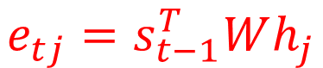
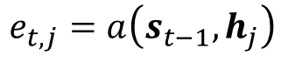
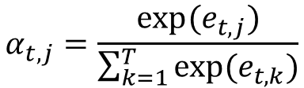
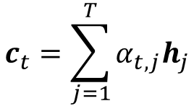
Attention variants
$$p\left(y_{t} | y_{t−1},…,y_{1},x\right)=f(y_{t−1},s_{t},c_{t})$$
$$c_{t}=\sum_{j=1}^{T}{α_{t,j}h_{j}}$$
$$α_{t,j}=\frac{exp⁡(e_{t,j})}{\sum_{k=1}^{T}{exp⁡(e_{t,k})}}$$
$$e_{t,j}=a\left(s_{t−1},h_{j}\right)$$
Multiplicative attention :
(bilinear model) If the dimensionality of hidden state and previous input are not equal: 较为general的表示
$$e_{tj}=s_{t−1}^{T}Wh_{j}$$

Slide 14
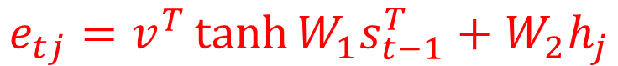
Attention variants
$$p\left(y_{t} | y_{t−1},…,y_{1},x\right)=f(y_{t−1},s_{t},c_{t})$$
$$c_{t}=\sum_{j=1}^{T}{α_{t,j}h_{j}}$$
$$α_{t,j}=\frac{exp⁡(e_{t,j})}{\sum_{k=1}^{T}{exp⁡(e_{t,k})}}$$
$$e_{t,j}=a\left(s_{t−1},h_{j}\right)$$
Additive attention (The equation of attention is not fixed).
$$e_{tj}=v^{T}\tanh{W_{1}s_{t−1}^{T}+W_{2}h_{j}}$$

Slide 15
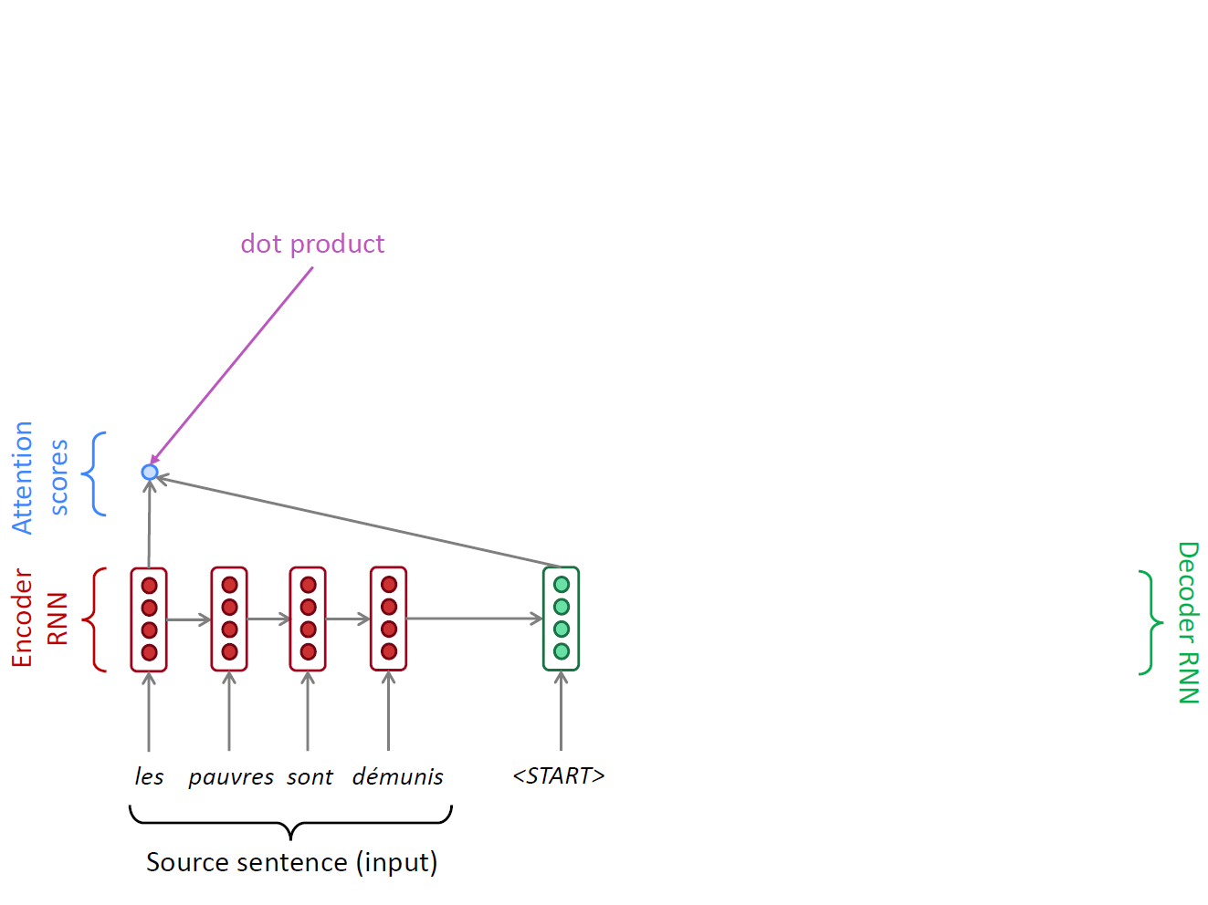
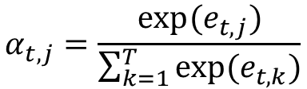
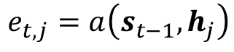
A Running Example
$$α_{t,j}=\frac{exp⁡(e_{t,j})}{\sum_{k=1}^{T}{exp⁡(e_{t,k})}}$$
$$e_{t,j}=a\left(s_{t−1},h_{j}\right)$$

Slide 16
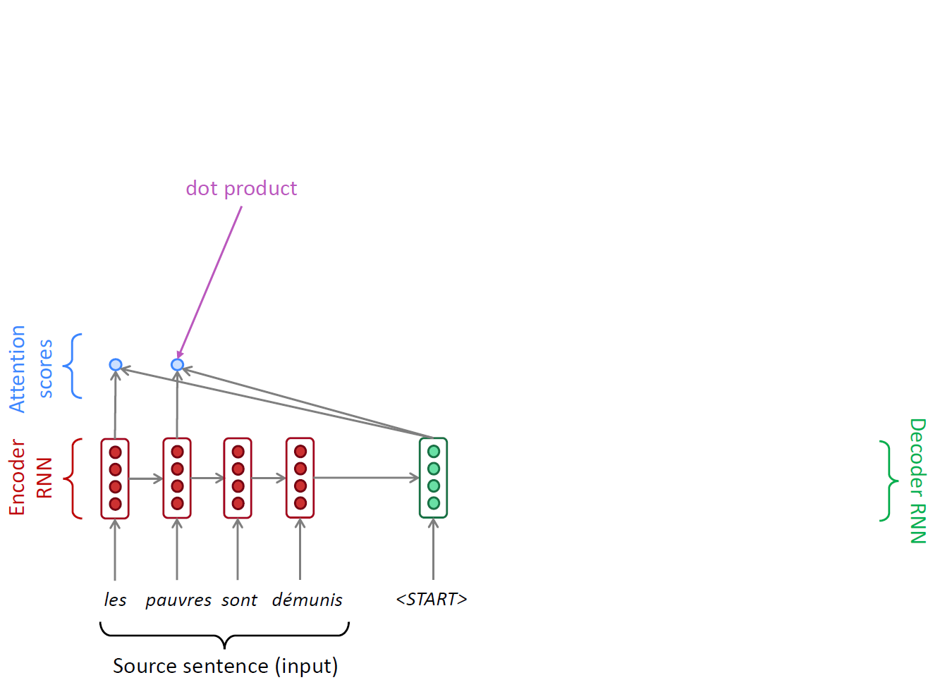
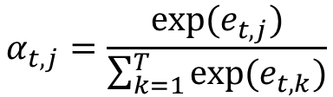
A Running Example
$$α_{t,j}=\frac{exp⁡(e_{t,j})}{\sum_{k=1}^{T}{exp⁡(e_{t,k})}}$$
$$e_{t,j}=a\left(s_{t−1},h_{j}\right)$$

Slide 17
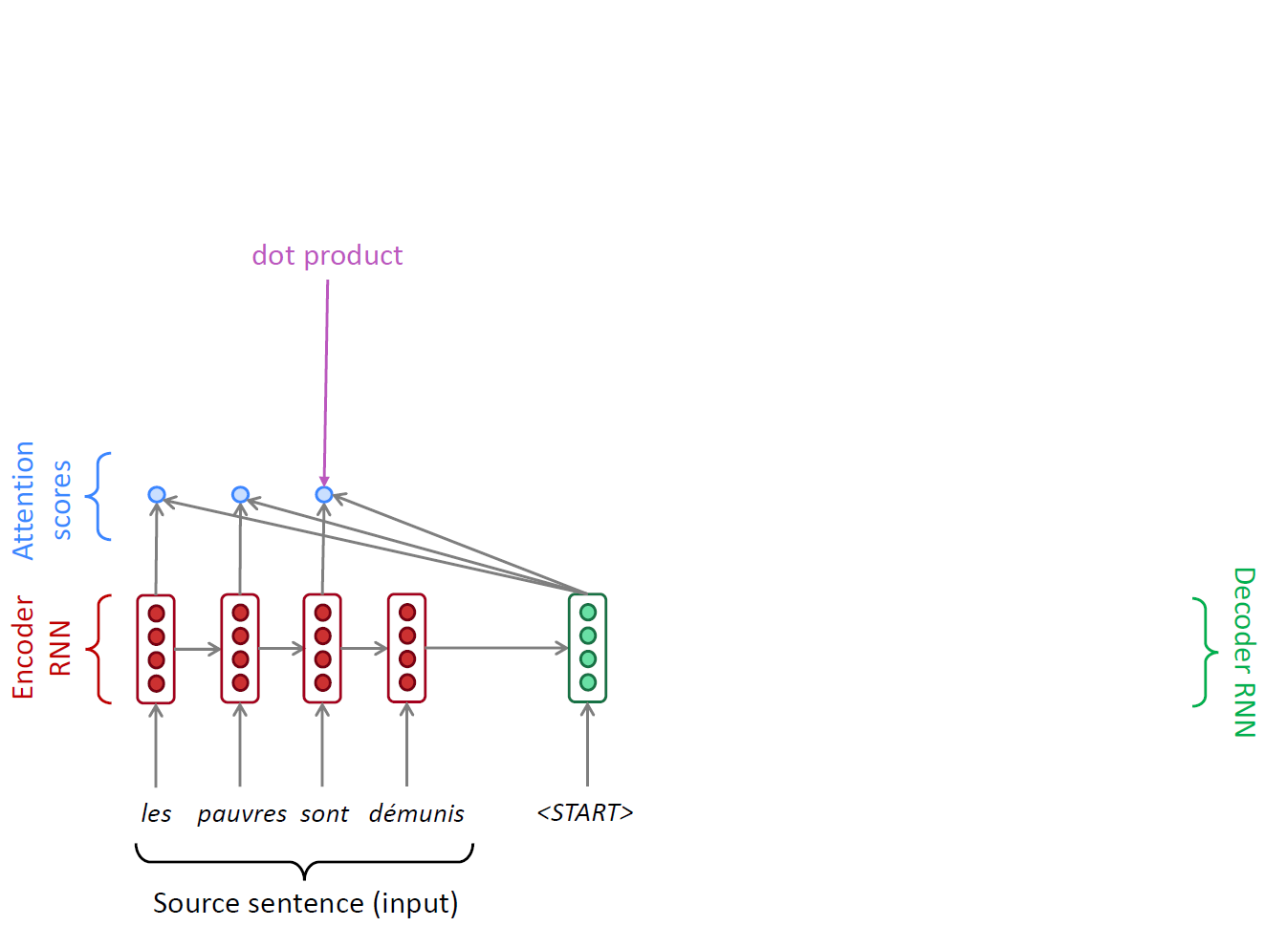
A Running Example
$$α_{t,j}=\frac{exp⁡(e_{t,j})}{\sum_{k=1}^{T}{exp⁡(e_{t,k})}}$$
$$e_{t,j}=a\left(s_{t−1},h_{j}\right)$$

Slide 18
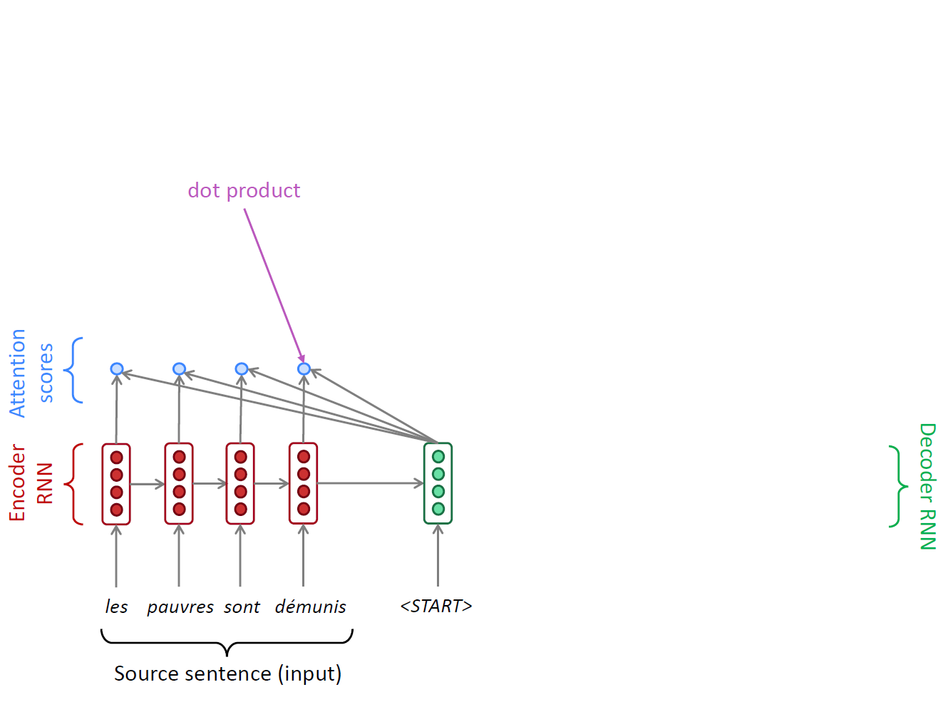
A Running Example
$$α_{t,j}=\frac{exp⁡(e_{t,j})}{\sum_{k=1}^{T}{exp⁡(e_{t,k})}}$$
$$e_{t,j}=a\left(s_{t−1},h_{j}\right)$$

Slide 19
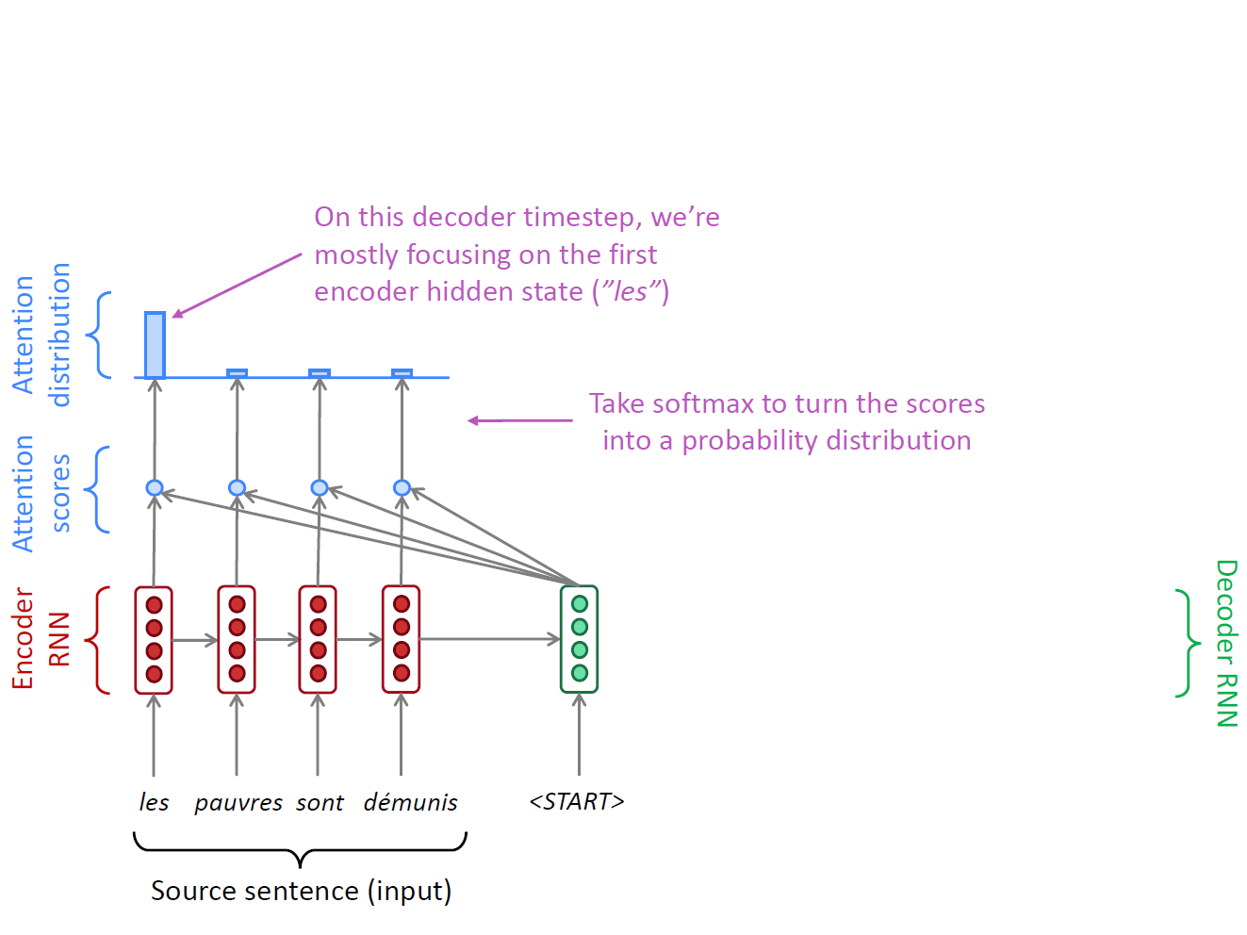
A Running Example
$$α_{t,j}=\frac{exp⁡(e_{t,j})}{\sum_{k=1}^{T}{exp⁡(e_{t,k})}}$$
$$e_{t,j}=a\left(s_{t−1},h_{j}\right)$$

Slide 20
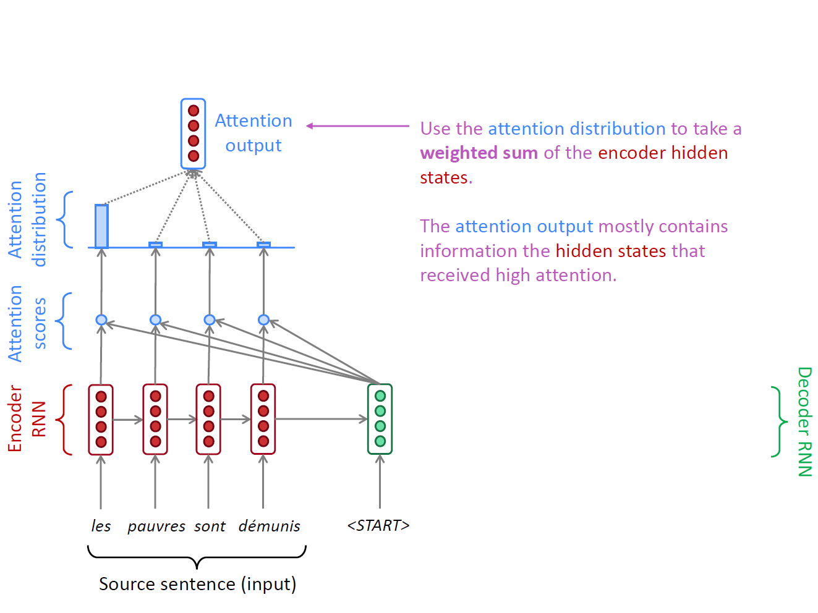
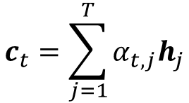
A Running Example
$$α_{t,j}=\frac{exp⁡(e_{t,j})}{\sum_{k=1}^{T}{exp⁡(e_{t,k})}}$$
$$c_{t}=\sum_{j=1}^{T}{α_{t,j}h_{j}}$$
$$e_{t,j}=a\left(s_{t−1},h_{j}\right)$$

Slide 21
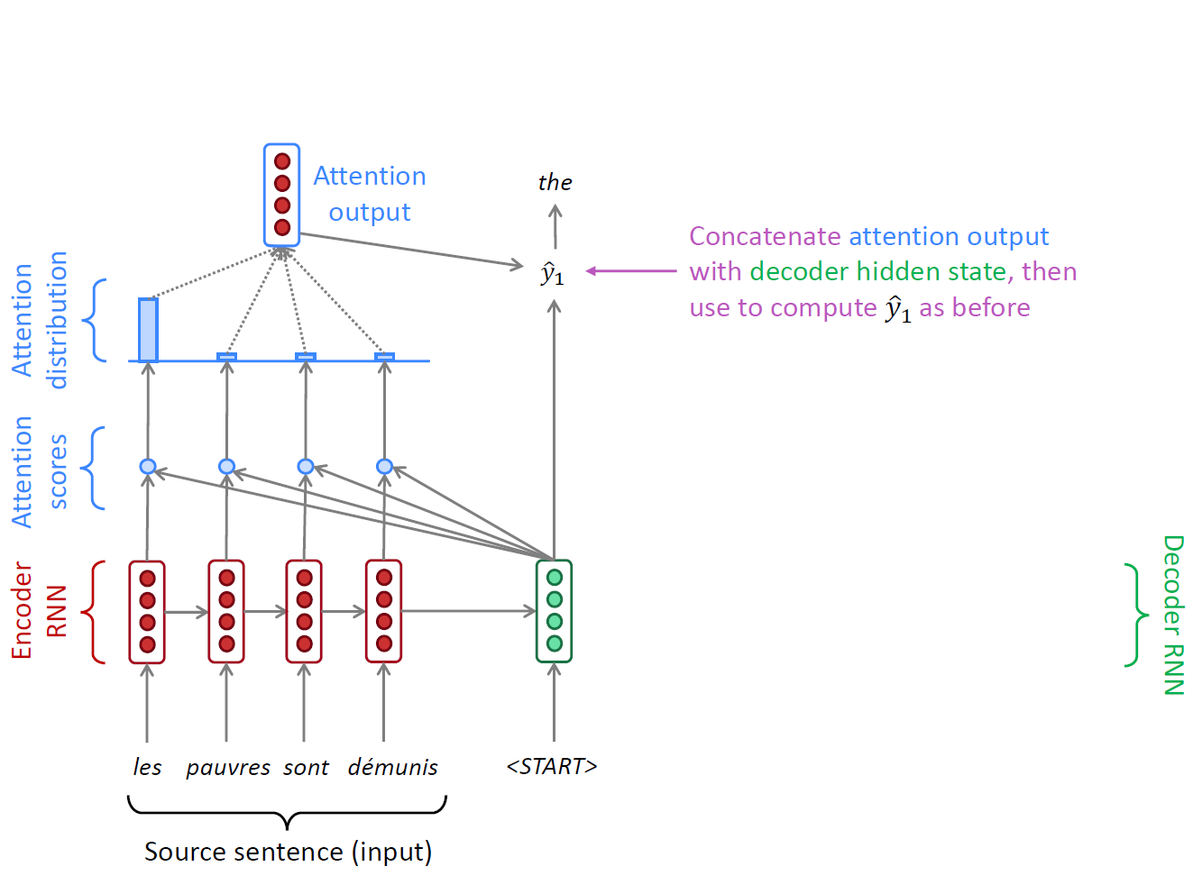
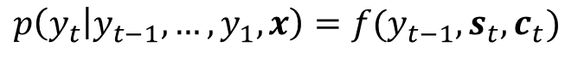
A Running Example
$$α_{t,j}=\frac{exp⁡(e_{t,j})}{\sum_{k=1}^{T}{exp⁡(e_{t,k})}}$$
$$c_{t}=\sum_{j=1}^{T}{α_{t,j}h_{j}}$$
$$p\left(y_{t} | y_{t−1},…,y_{1},x\right)=f(y_{t−1},s_{t},c_{t})$$
$$e_{t,j}=a\left(s_{t−1},h_{j}\right)$$
ct: “context vector”

Slide 22
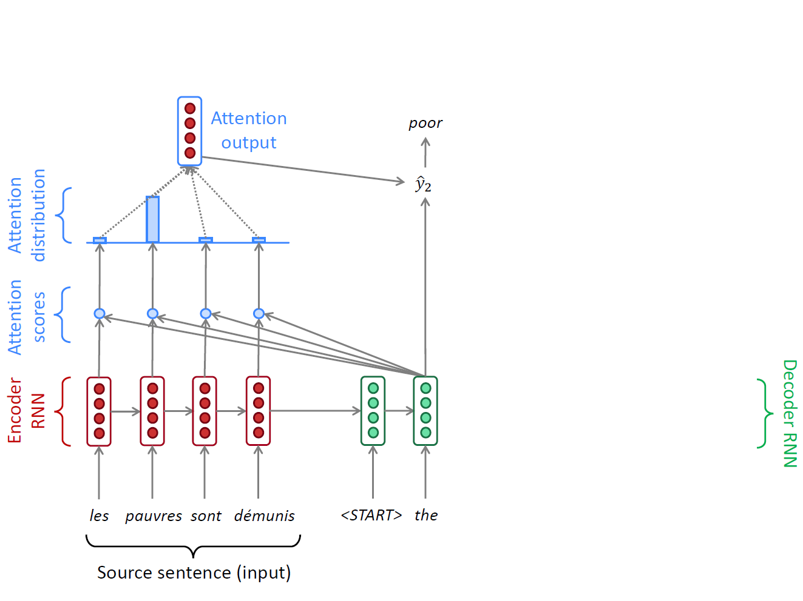
A Running Example
$$α_{t,j}=\frac{exp⁡(e_{t,j})}{\sum_{k=1}^{T}{exp⁡(e_{t,k})}}$$
$$c_{t}=\sum_{j=1}^{T}{α_{t,j}h_{j}}$$
$$p\left(y_{t} | y_{t−1},…,y_{1},x\right)=f(y_{t−1},s_{t},c_{t})$$
$$e_{t,j}=a\left(s_{t−1},h_{j}\right)$$

Slide 23
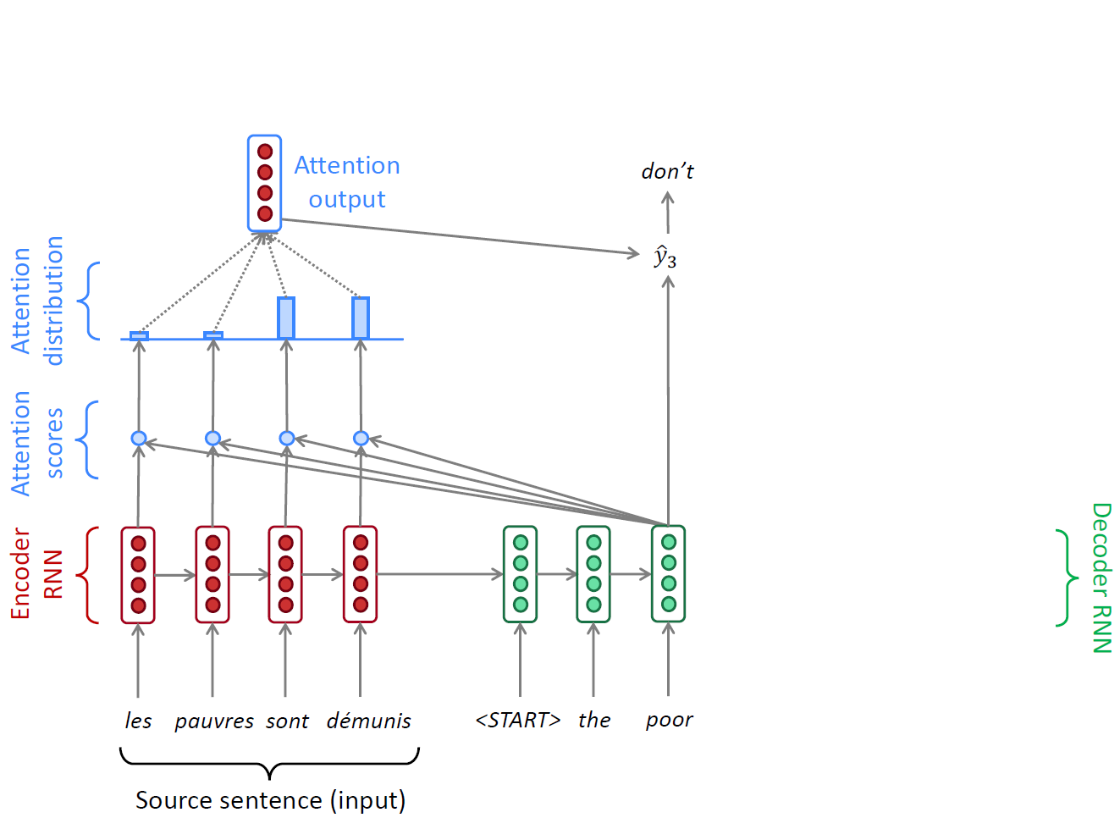
A Running Example
$$α_{t,j}=\frac{exp⁡(e_{t,j})}{\sum_{k=1}^{T}{exp⁡(e_{t,k})}}$$
$$c_{t}=\sum_{j=1}^{T}{α_{t,j}h_{j}}$$
$$p\left(y_{t} | y_{t−1},…,y_{1},x\right)=f(y_{t−1},s_{t},c_{t})$$
$$e_{t,j}=a\left(s_{t−1},h_{j}\right)$$

Slide 24
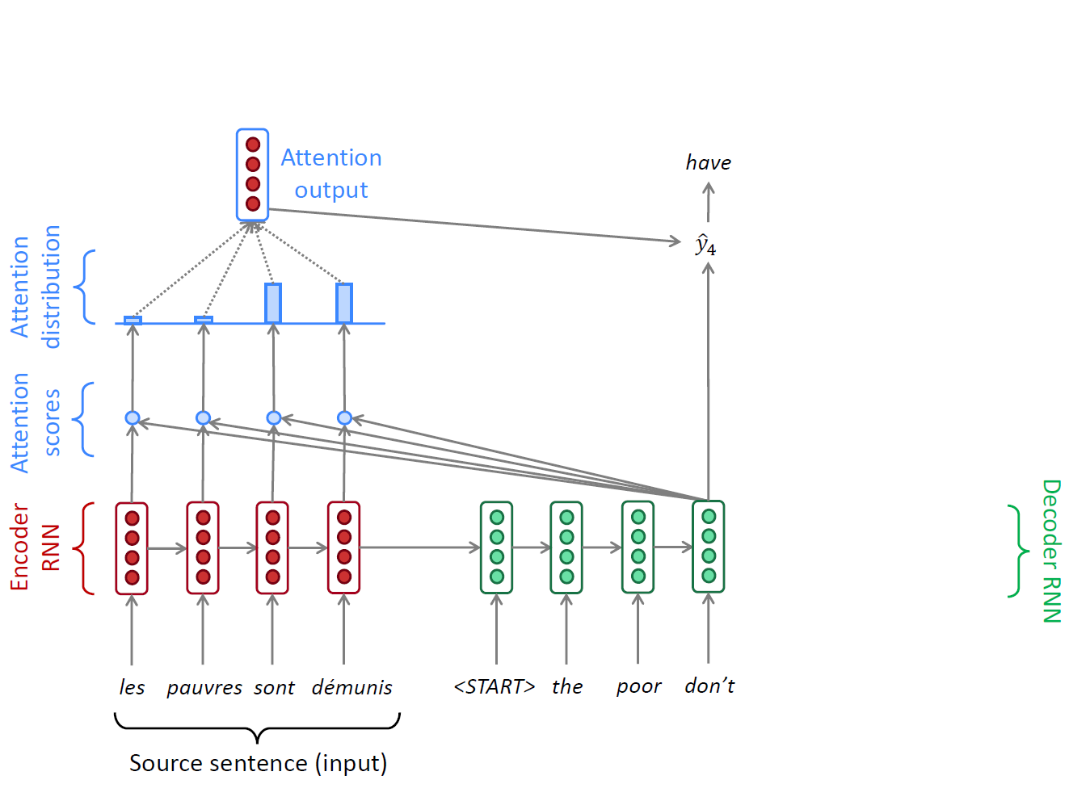
A Running Example
$$α_{t,j}=\frac{exp⁡(e_{t,j})}{\sum_{k=1}^{T}{exp⁡(e_{t,k})}}$$
$$c_{t}=\sum_{j=1}^{T}{α_{t,j}h_{j}}$$
$$p\left(y_{t} | y_{t−1},…,y_{1},x\right)=f(y_{t−1},s_{t},c_{t})$$
$$e_{t,j}=a\left(s_{t−1},h_{j}\right)$$

Slide 25
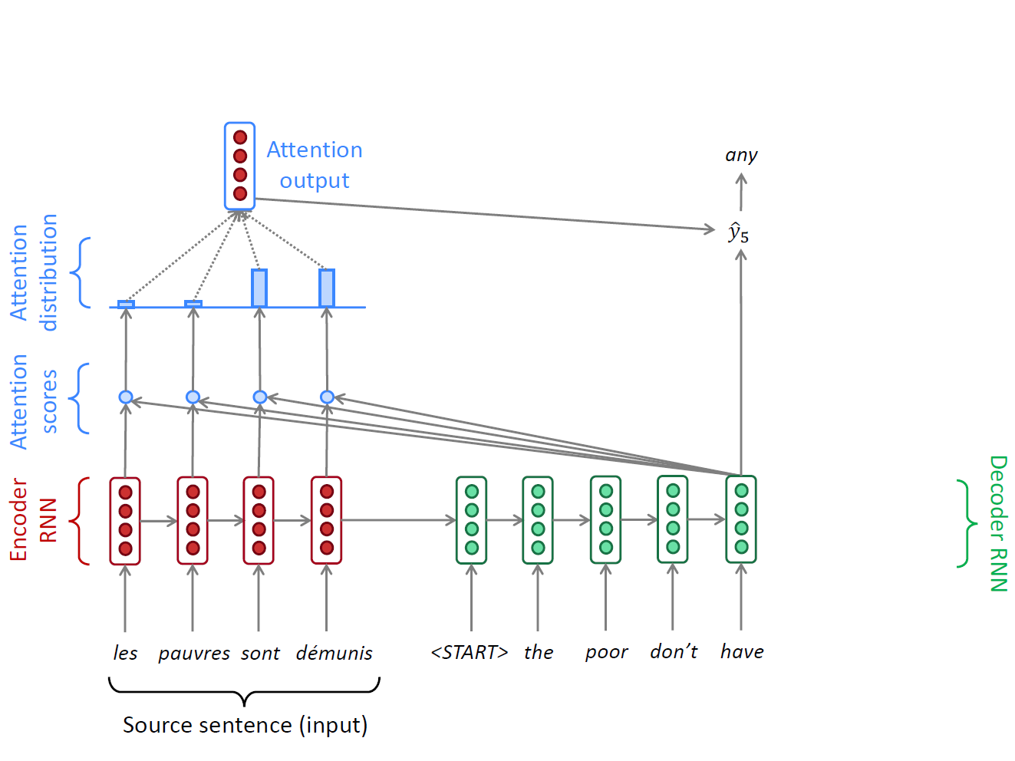
A Running Example
$$α_{t,j}=\frac{exp⁡(e_{t,j})}{\sum_{k=1}^{T}{exp⁡(e_{t,k})}}$$
$$c_{t}=\sum_{j=1}^{T}{α_{t,j}h_{j}}$$
$$p\left(y_{t} | y_{t−1},…,y_{1},x\right)=f(y_{t−1},s_{t},c_{t})$$
$$e_{t,j}=a\left(s_{t−1},h_{j}\right)$$

Slide 26
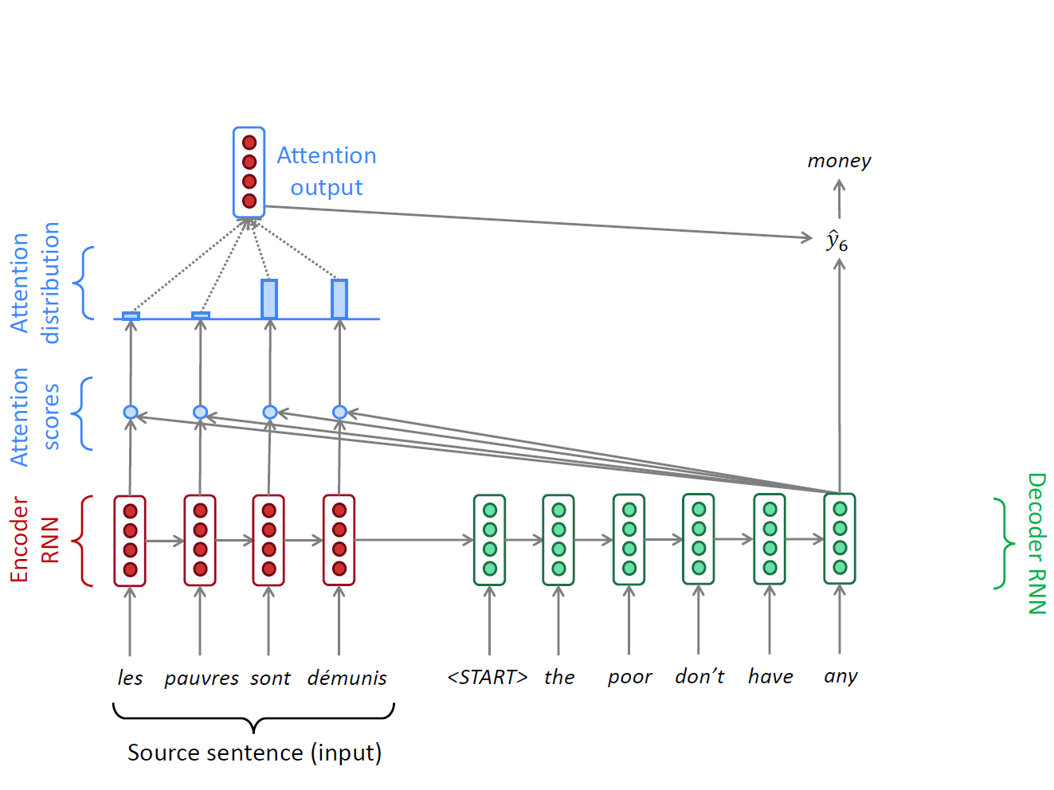
A Running Example
$$α_{t,j}=\frac{exp⁡(e_{t,j})}{\sum_{k=1}^{T}{exp⁡(e_{t,k})}}$$
$$c_{t}=\sum_{j=1}^{T}{α_{t,j}h_{j}}$$
$$p\left(y_{t} | y_{t−1},…,y_{1},x\right)=f(y_{t−1},s_{t},c_{t})$$
$$e_{t,j}=a\left(s_{t−1},h_{j}\right)$$

Slide 27
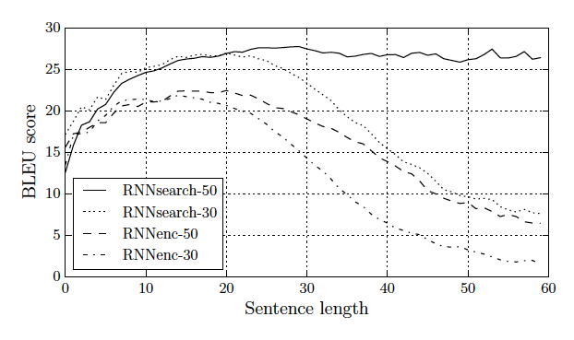
Jointly Learning to Align and Translate
No performance drop for long sentences
“We train each model twice: first with the sentences of length up to 30 words (RNNencdec-30, RNNsearch-30) and then with the sentences of length up to 50 word (RNNencdec-50, RNNsearch-50).”
RNNencdec: Cho et al. 2014 https://www.aclweb.org/anthology/D14-1179
RNNsearch: Bahdanauet al, ICLR 2015, https://arxiv.org/pdf/1409.0473.pdf

Slide 28
OpenNMT
http://opennmt.net/

Slide 29
Google Neural Machine Translation (Wu et al. (2016))

Slide 30
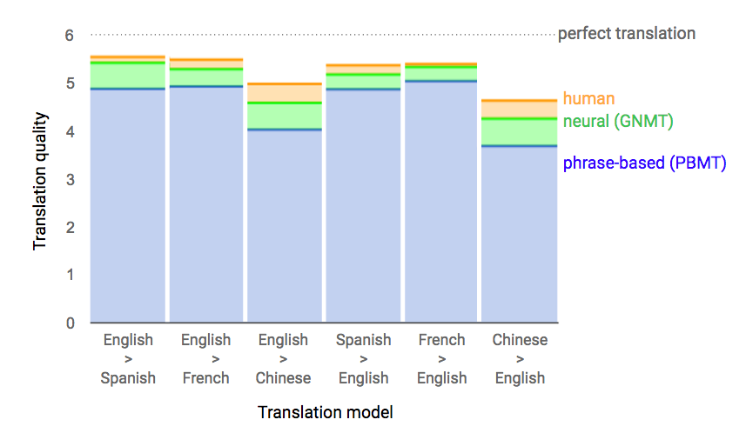
Google Neural Machine Translation (Wu et al. (2016))
https://ai.googleblog.com/2016/09/a-neural-network-for-machine.html

Slide 31
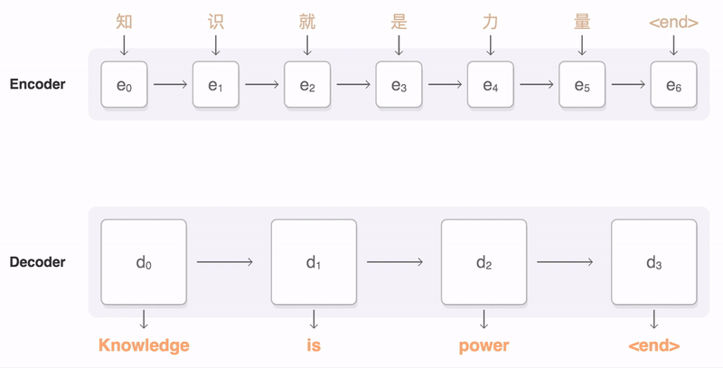
Google Neural Machine Translation (Wu et al. (2016))
https://ai.googleblog.com/2016/09/a-neural-network-for-machine.html

Slide 32
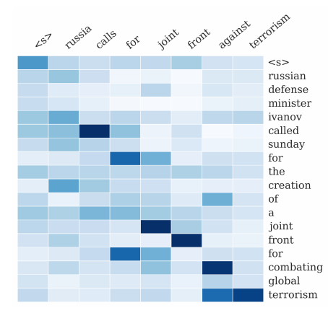
Summary
Attention significantly improves NMT performance
It’s very useful to allow decoder to focus on certain parts of the source
Attention solves the bottleneck problem
Attention allows decoder to look directly at source; bypass bottleneck
Attention helps with vanishing gradient problem: 会回顾encoder中很靠前的state
Provides shortcut to faraway states
Attention provides some interpretability
By inspecting attention distribution, we can see what the decoder was focusing on
We get alignment for free!
This is cool because we never explicitly trained an alignment system
The network just learned alignment by itself

Slide 33
Sequence-to-sequence is versatile!
Sequence-to-sequence is useful for more than just MT
Many NLP tasks can be phrased as sequence-to-sequence:
Summarization (long text → short text)
Dialogue (previous utterances → next utterance)
Parsing (input text → output parse as sequence)
Code generation (natural language → Python code)

Slide 34
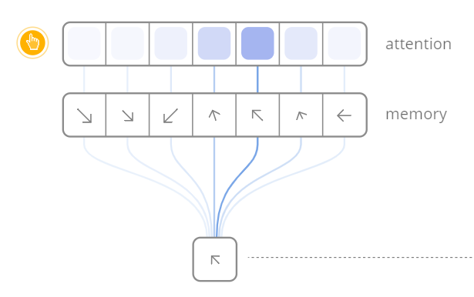
Attention is a general Deep Learning technique
More general definition of attention
Given a set of vector values, and a vector query, attention is a technique to compute a weighted sum of the values, dependent on the query.
We sometimes say that the query attends to the values
For example, in the seq2seq + attention model, each decoder hidden state attends to the encoder hidden states
https://distill.pub/2016/augmented-rnns/

Slide 35
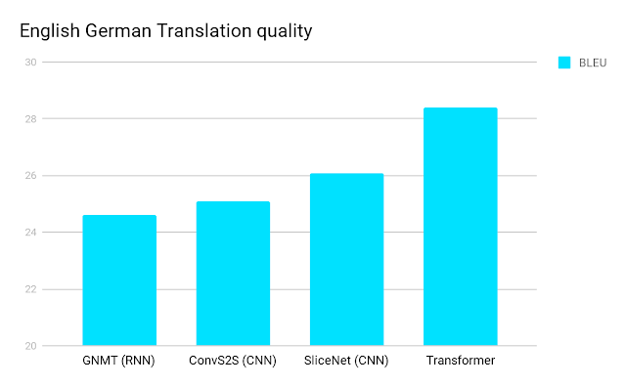
Attention is all you need?
– Transformer Networks
https://ai.googleblog.com/2017/08/transformer-novel-neural-network.html

Slide 36
Problems with RNNs = Motivation for Transformers
Recurrent models typically factor computation along the symbol positions of the input and output sequences
Sequential computation prevents parallelization
Critical at longer sequence lengths, as memory constraints limit batching across examples
Despite advanced RNNs like LSTMs, RNNs still need attention mechanism to deal with long range dependencies – path length for codependent computation between states grows with sequence
But if attention gives us access to any state… maybe we don’t need the RNN?

Slide 37
Transformer Overview
Sequence-to-sequence
Encoder-Decoder
Task: machine translation with parallel corpus
Predict each translated word
Final cost/error function is standard cross-entropy error on top of a softmax classifier
https://arxiv.org/pdf/1706.03762.pdf

Slide 38
Transformer Basics
Let’s define the basic building blocks of transformer networks first: new attention layers!

Slide 39
Dot-Product Attention (Extending our previous def.)
Inputs: a query q and a set of key-value (k-v) pairs to an output
Query, keys, values, and output are all vectors
Output is weighted sum of values, where
Weight of each value is computed by an inner product of query and corresponding key
Queries and keys have same dimensionality

Slide 40
Dot-Product Attention – Matrix notation
When we have multiple queries q, we stack them in a matrix Q:
Becomes:
dk: number of keys; dv: number of values. Number of queries should be the same as dk.

Slide 41
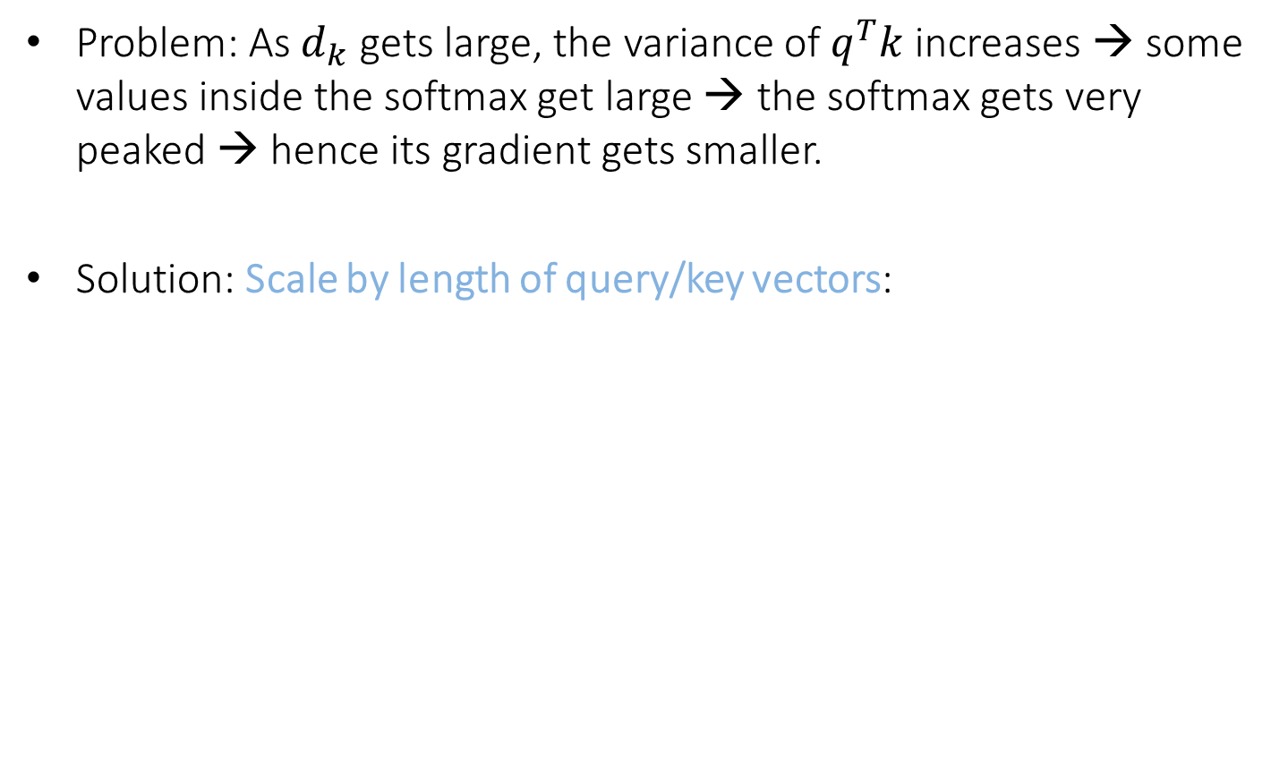
Scaled Dot-Product Attention
Problem: As $d_{k}$ gets large, the variance of $q^{T}k$ increases → some values inside the softmax get large → the softmax gets very peaked → hence its gradient gets smaller.
Solution: Scale by length of query/key vectors:

Slide 42
Self-attention and Multi-head attention
The input word vectors could be the queries, keys and values
In other words: the word vectors themselves select each other
Word vector stack = Q = K = V
Problem: Only one way for words to interact with one-another
Solution: Multi-head attention
First map Q, K, V into h many lower dimensional spaces via W matrices
Then apply attention, then concatenate outputs and pipe through linear layer

Slide 43
Self-Attention
(example and picture from David Talbot)

Slide 44
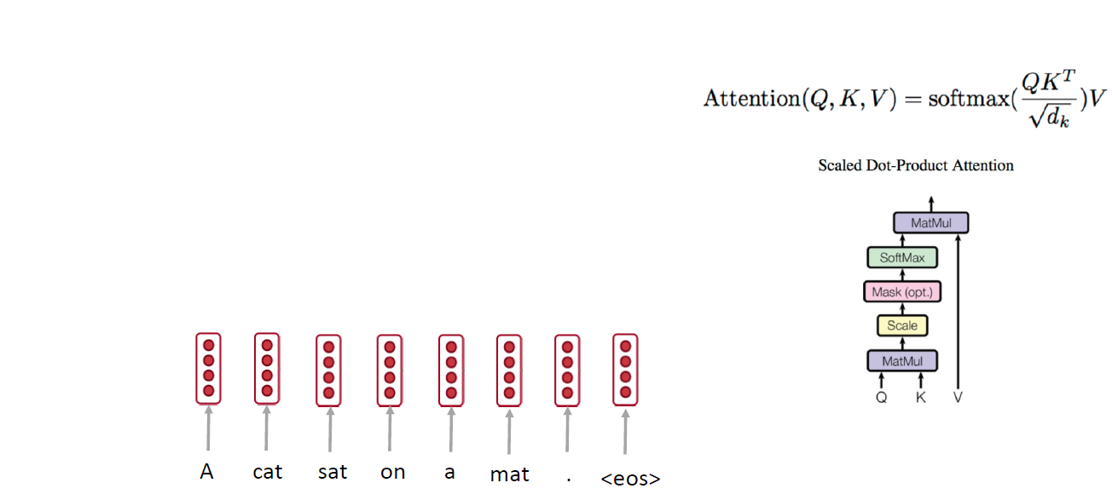
Self-attention: A Running Example

Slide 45
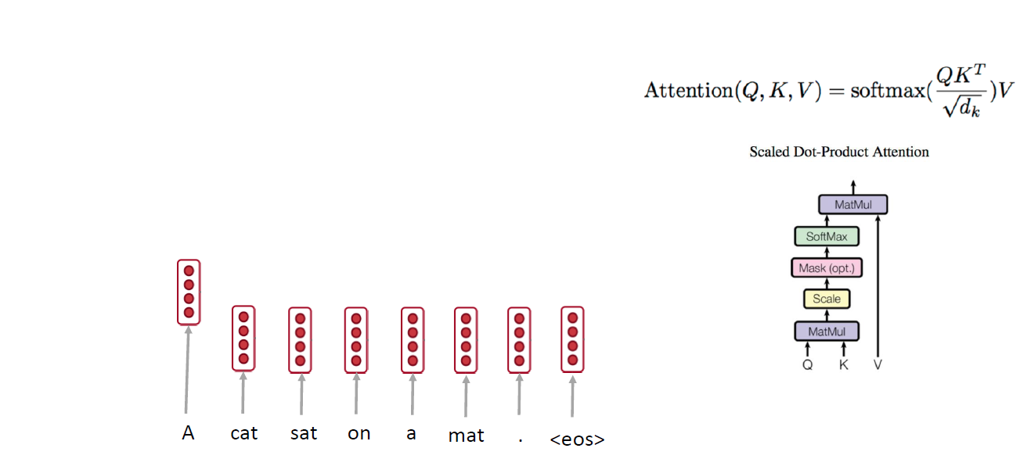
Self-attention: A Running Example

Slide 46
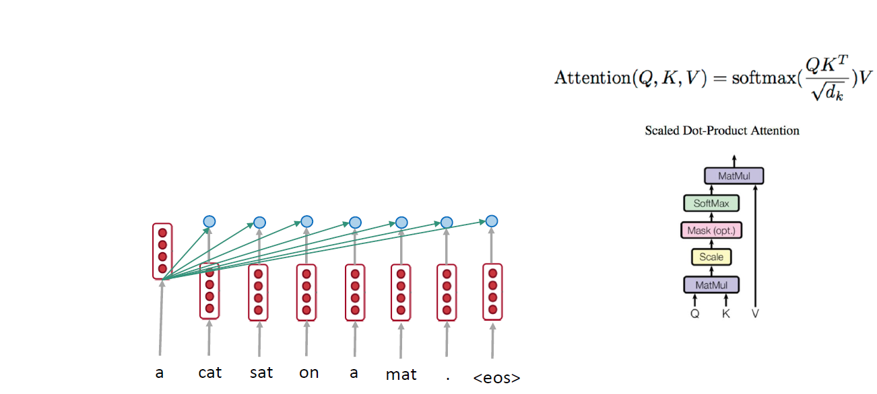
Self-attention: A Running Example

Slide 47
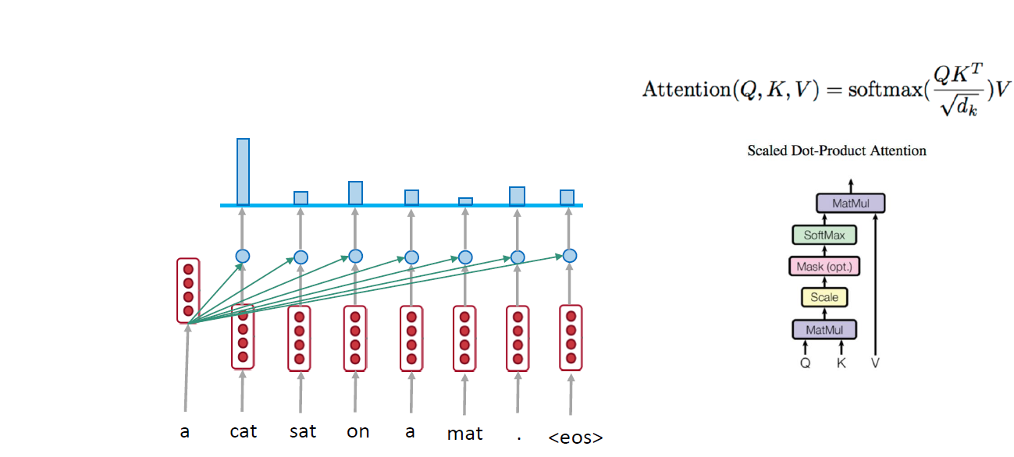
Self-attention: A Running Example
Generate a new embedding vector based on my attention. Even in the same language, we can do attention.

Slide 48
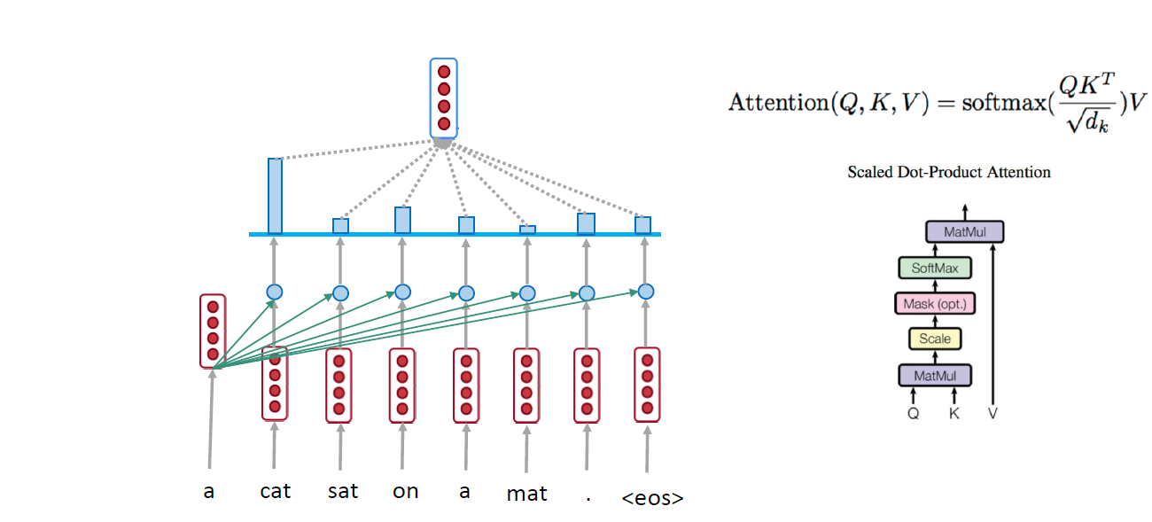
Self-attention: A Running Example

Slide 49
Self-attention: A Running Example

Slide 50
Self-attention: A Running Example

Slide 51
Self-attention: A Running Example

Slide 52
Self-attention: A Running Example
Decide which words in the context are important for representing “on”

Slide 53
Self-attention: A Running Example

Slide 54
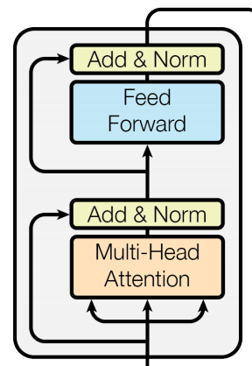
Complete transformer block
Each block has two “sublayers”
1. Multihead attention
2. 2 layer feed-forward Nnet (with relu)
Each of these two steps also has:
Residual (short-circuit) connection and LayerNorm:
LayerNorm(x + Sublayer(x))
Layernorm changes input to have mean 0 and variance 1, per layer and per training point (and adds two more parameters)
Layer Normalization by Ba, Kiros and Hinton, https://arxiv.org/pdf/1607.06450.pdf

Slide 55
Blocks are repeated N=6 times

Slide 56
Encoder Input
Actual word representations are byte-pair encodings
Rico Sennrich, Barry Haddow, and Alexandra Birch. Neural Machine Translation of Rare Words with Subword Units. ACL 2016.
Added is a positional encoding so same words at different locations have different overall representations:
pos is the position of a word
i is the dimension index

Slide 57
Self Attention Visualization in Layer 5
Words start to pay attention to other words in sensible ways
Padding node, contribute nothing to the softmax.

Slide 58
Transformer Decoder
2 sublayer changes in decoder
Masked decoder self-attention
Only depends on previous words, we don’t see the future
Encoder-Decoder Attention
Queries come from previous decoder layer and keys and values come from output of encoder

Slide 59
Advantages
No recurrence: parallel encoding
Fast training: both encoder and decoder are parallel
No long range problem: O(1) for all tokens direct connections
Three attentions: the model does not have to remember too much
Multi-head attention allows to pay attention to different aspects
Why self-attention and CNN is better than RNN on NMT is still under investigation
A comparison of RNN, CNN, and self-attention
http://aclweb.org/anthology/D18-1458

Slide 60

Transformer Networks Visualization
https://ai.googleblog.com/2017/08/transformer-novel-neural-network.html

Slide 61
Google’s BERT
Training of BERT-BASE was performed on 4 Cloud TPUs in Pod configuration (16 TPU chips total).
Training of BERT-LARGE was performed on 16 Cloud TPUs (64 TPU chips total).
Each pre-training took 4 days to complete.
https://ai.googleblog.com/2018/11/open-sourcing-bert-state-of-art-pre.html
https://arxiv.org/pdf/1810.04805.pdf

Slide 62
Grammar as a Foreign Language
Vinyals et al., 2015

Slide 63
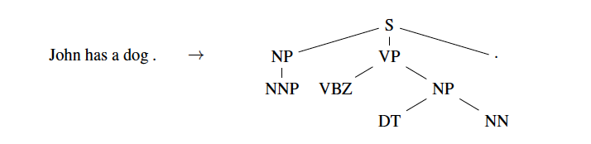
Grammar as a Foreign Language
Parsing tree

Slide 64
Grammar as a Foreign Language
Parsing tree

Slide 65
Grammar as a Foreign Language
Parsing tree

Slide 66
Grammar as a Foreign Language
Parsing tree

Slide 67
Grammar as a Foreign Language
Parsing tree
John has a dog .

Slide 68

Grammar as a Foreign Language
Converting tree to sequence
Use pre-order to traverse the tree and convert a tree problem to a sequence problem.

Slide 69
Grammar as a Foreign Language
Converting tree to sequence

Slide 70

Grammar as a Foreign Language
Model

Slide 71

Grammar as a Foreign Language
Results

